Slide 1
SQL Project –
E-commerce Sales Analysis

Slide 2
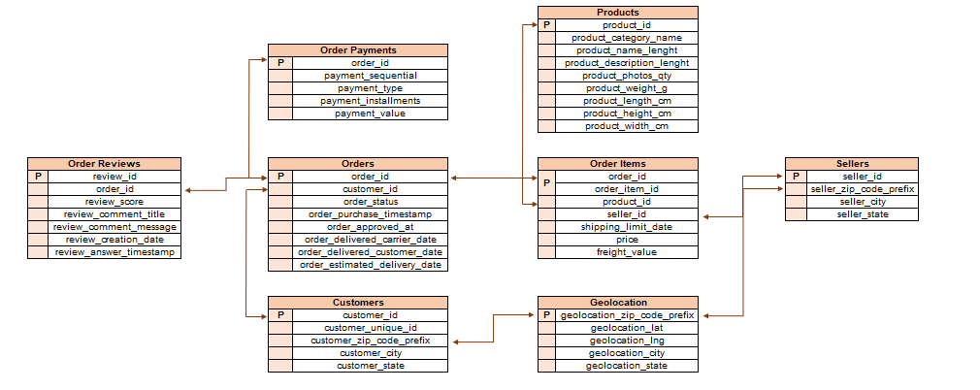
DATA OVERVIEW

Slide 3

PROJECT OVERVIEW - 1
Your client, a Brazilian E-commerce store, wants you to help them understand how their sales trend across different states over the years and why?.
For this analysis, you are given the data for the time period 2016-2018
a. Create the different metrics like Sales, customer acquisitions, total no. of orders for each Year across the different states they serve.
Does all the metrics show similar trends or is there any disparity amongst each of them?
b. Using the above metrics, identify the top 2 States which show
i. Declining trend over the years
ii. Increasing trend over the years
(Choose yourself the best suited metrics amongst all 3 in point (a) to carry out the analysis)
c. For the States identified above, do the Root Cause analysis for their performance across a variety of metrics.
You can utilize the following metrics and explore a few yourself as well by analyzing the data.
Category level Sales and orders placed, post-order reviews, Seller performance in terms of deliveries, product-level sales & orders placed,
% of orders delivered earlier than the expected date, % of orders delivered later than the expected date, etc.

Slide 4
PROJECT OVERVIEW - 2
d. Do the above analysis for the top 2 cities which are causing the trend for each of the states identified in point (b)
e. After doing the Root cause analysis, help the client by suggesting ways to improve the performance of the States and the cities
Provide your findings in an excel workbook, plot graphs & create multiple tabs as needed.

Slide 5
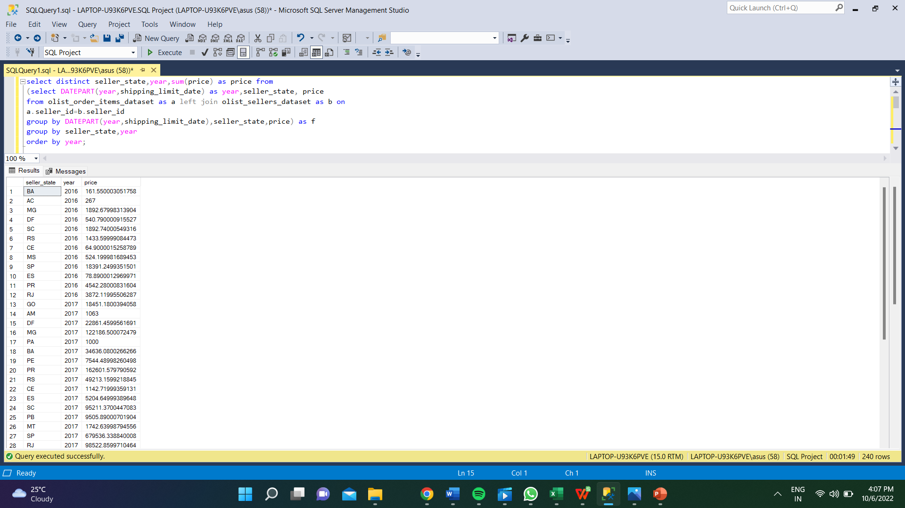
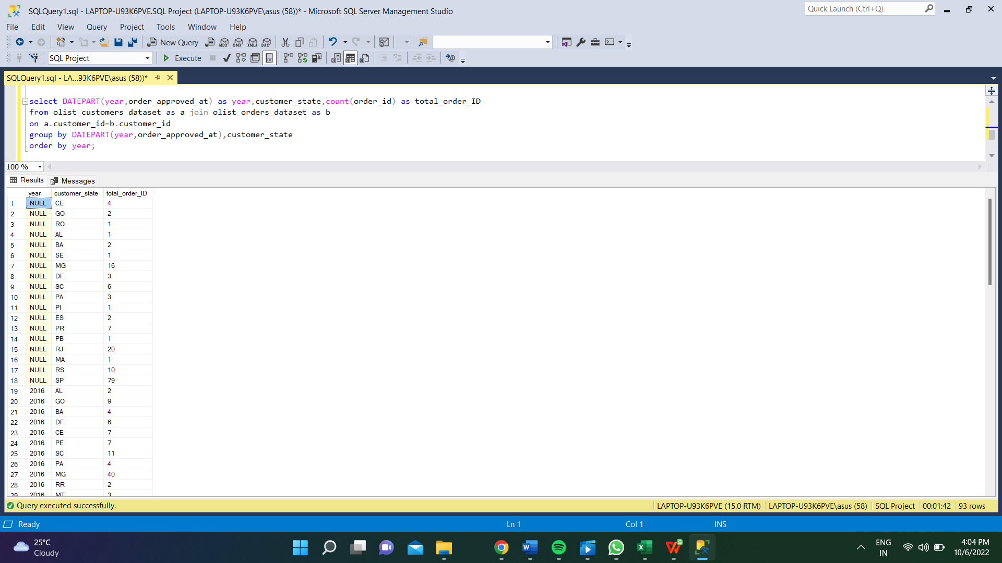
a. Create the different metrics like Sales, customer acquisitions, total no. of orders
for each Year across the different states they serve.Does all the metrics show similar trends or is there any disparity amongst each of them?
Sales in every state
Total OrderID in Every state

Slide 6
For getting information about inclined and declined trend over the year for price and total ID

Slide 7
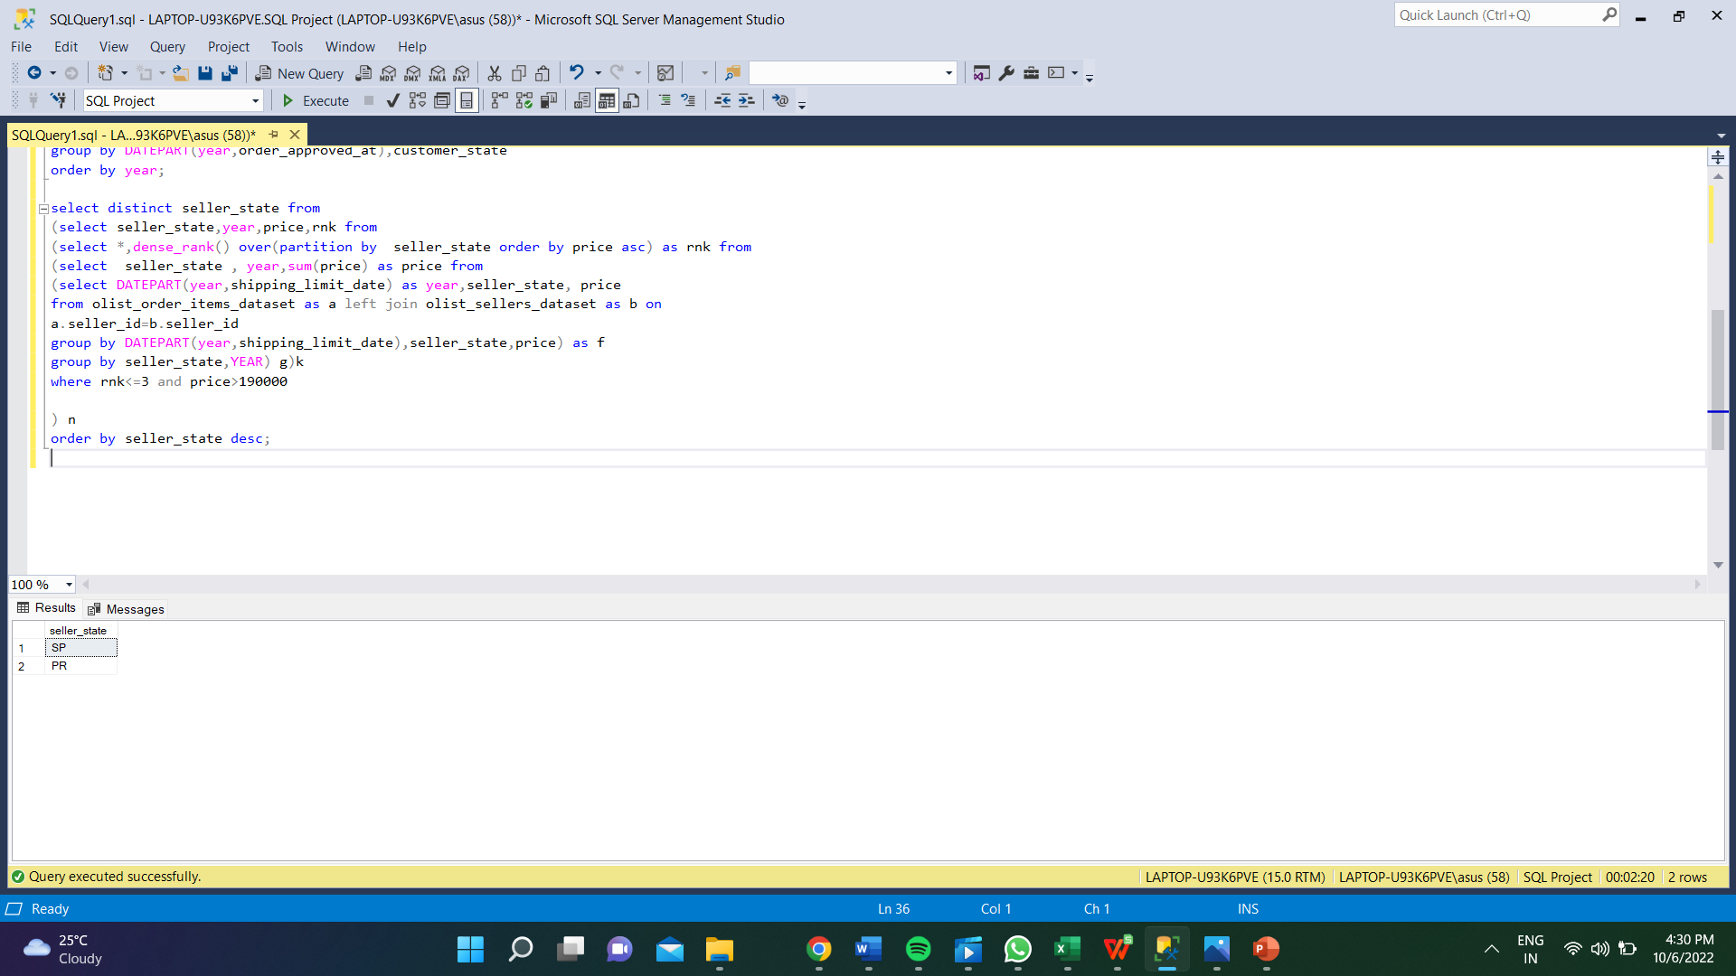
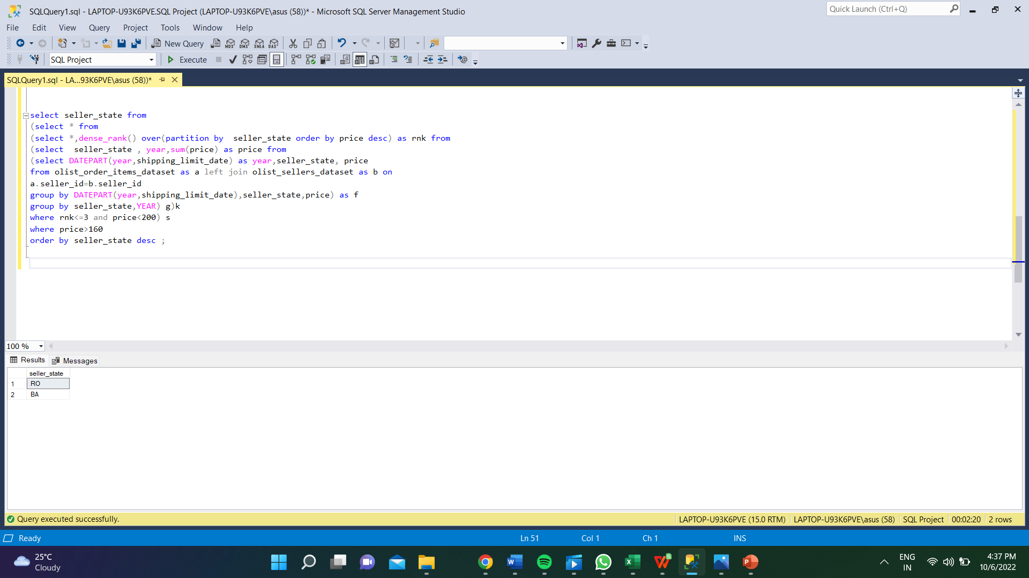
. Using the above metrics, identify the top 2 States which show
i. Declining trend over the years
ii. Increasing trend over the years
Increasing trend over the years
Declining trend over the years

Slide 8
Using the above metrics, identify the top 2 States which show
i. Declining trend over the years
ii. Increasing trend over the years

Slide 9
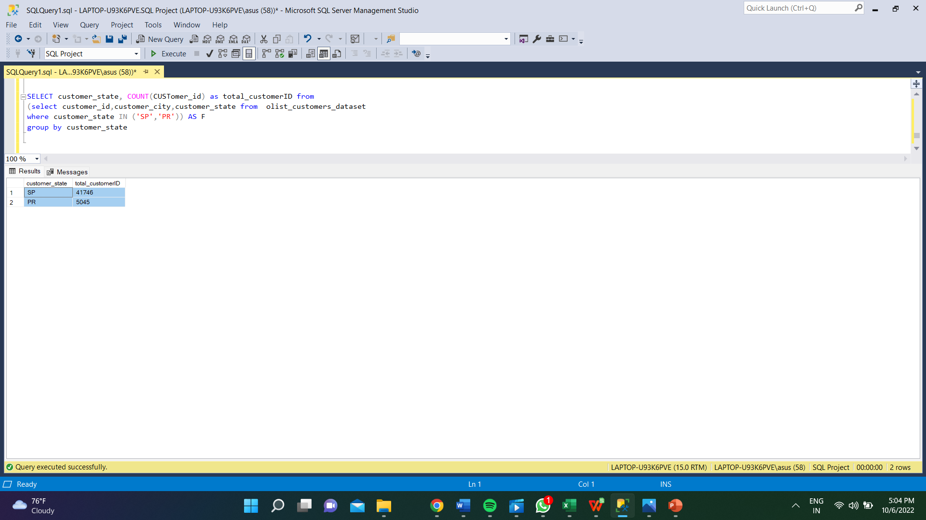
c. For the States identified above, do the Root Cause analysis for their performance across a variety of metrics.
You can utilize the following metrics and explore a few yourself as well by analyzing the data.
Category level Sales and orders placed, post-order reviews, Seller performance in terms of deliveries, product-level sales & orders placed,
% of orders delivered earlier than the expected date, % of orders delivered later than the expected date, etc.
Total CustomerID from top state

Slide 10
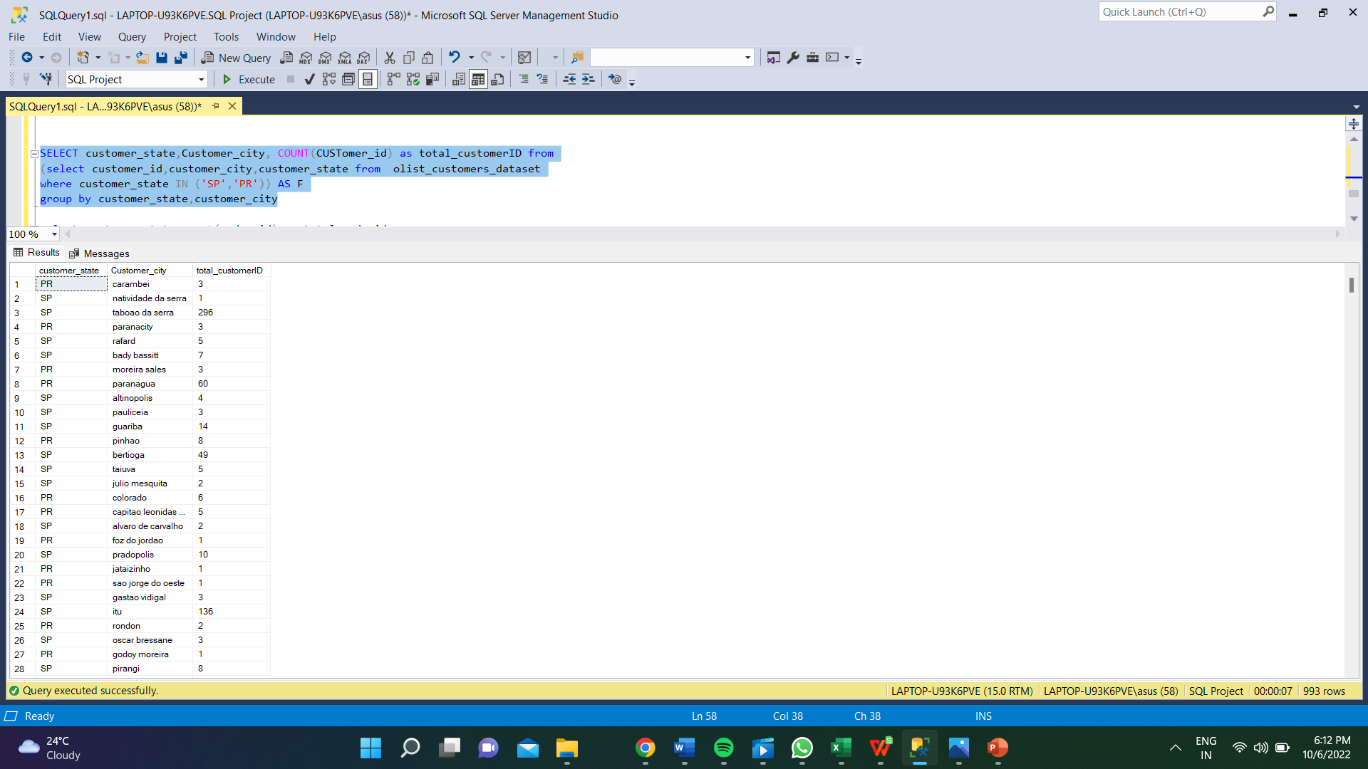
Total CustomerID in City of Top 2 State

Slide 11
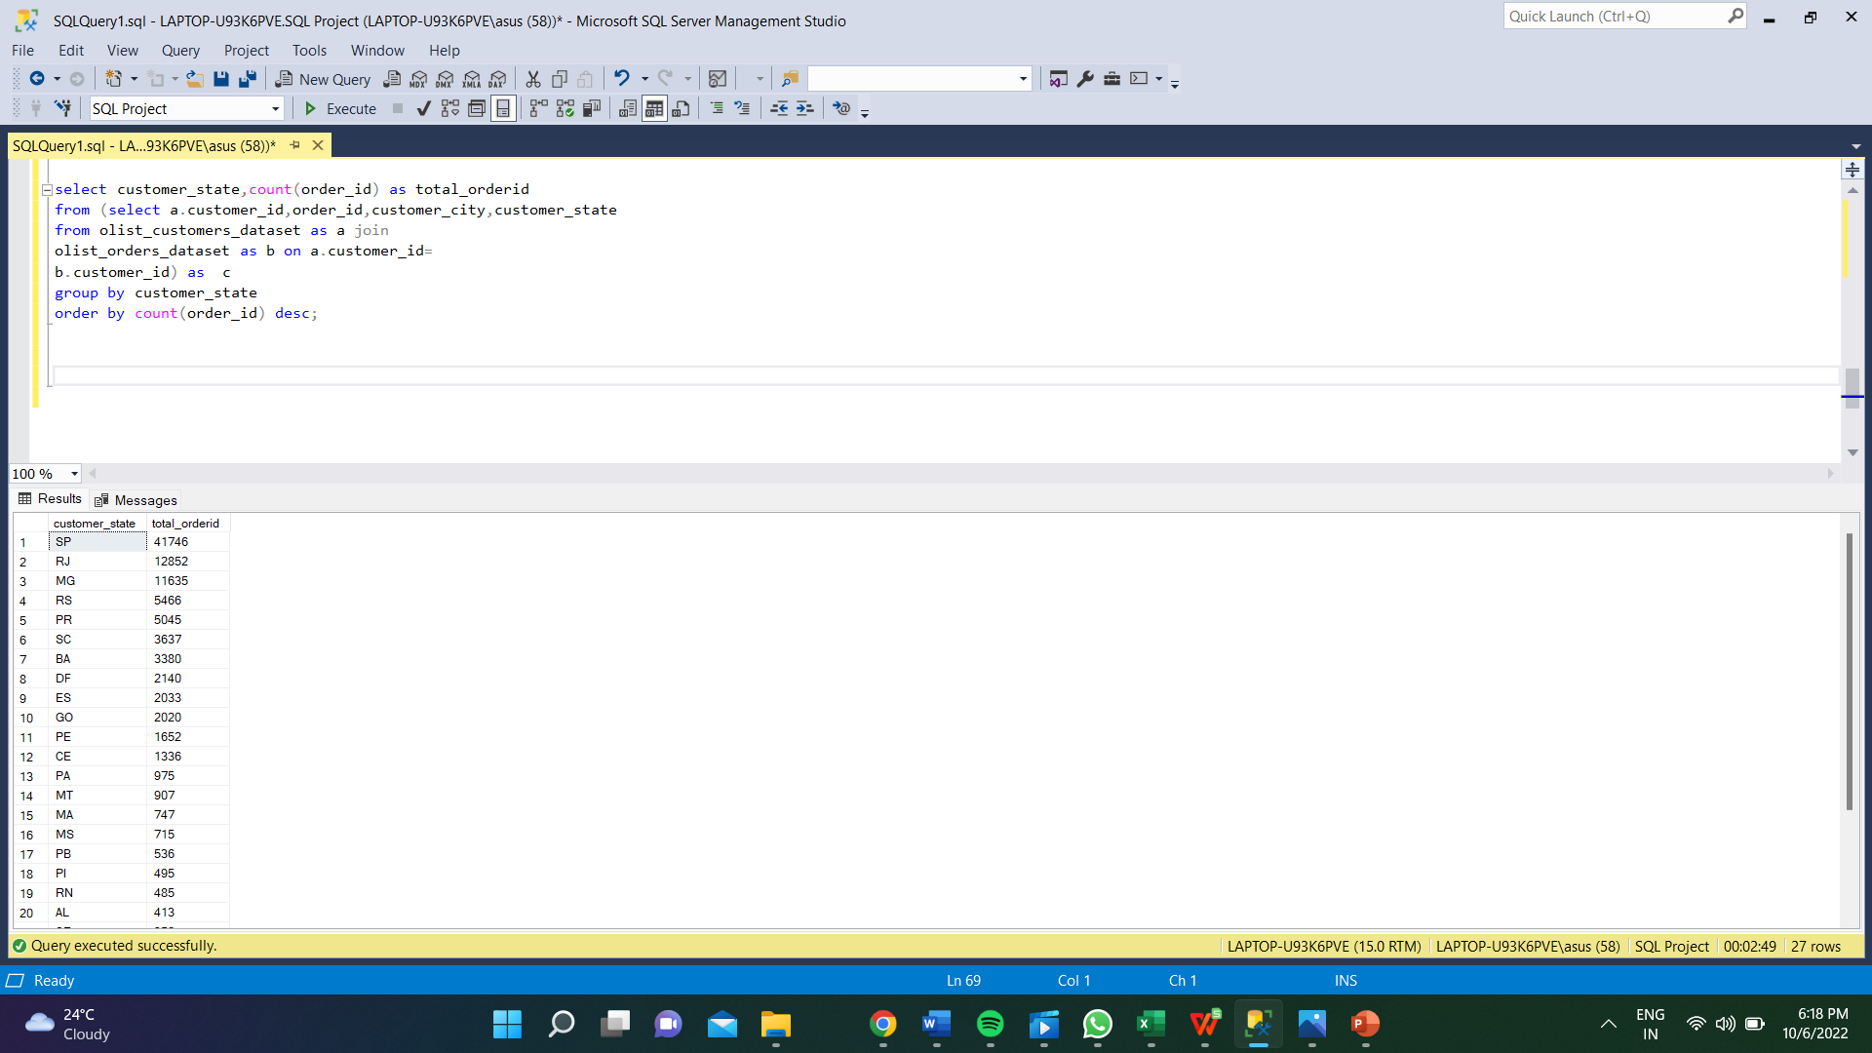
Total OrderID in every state

Slide 12
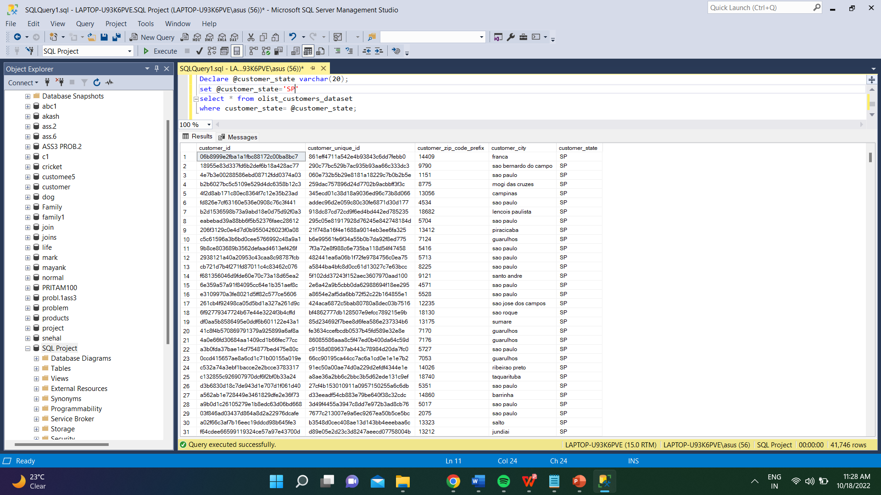

Total customerID in Inclined and Declined trend state
SP
ii. PR

Slide 13


iii. RO
iv. BA

Slide 14
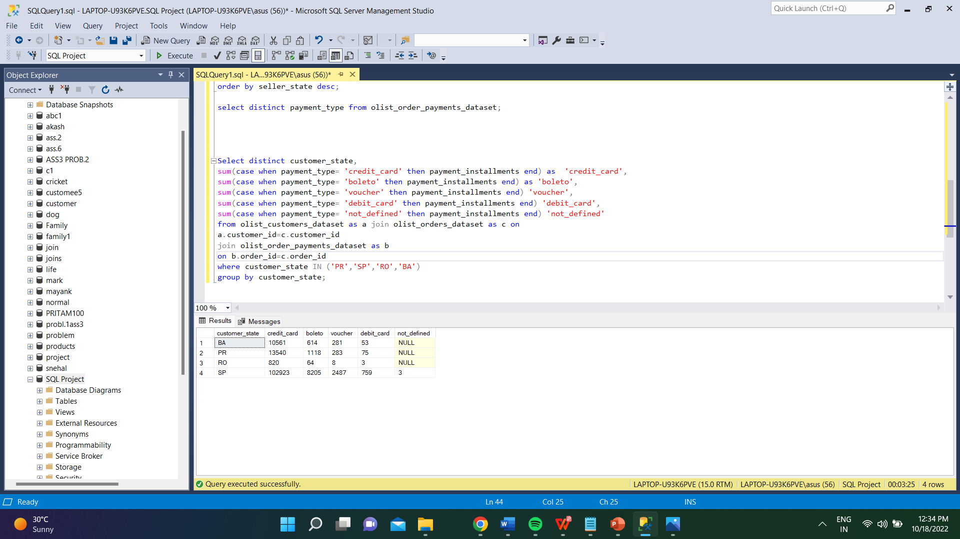
Type of payment mode and there count payment type

Slide 15
 | credit_card | boleto | voucher | debit_card | not_defined
RO | 820 | 64 | 8 | 3 | NULL
BA | 10561 | 614 | 281 | 53 | NULL
PR | 13540 | 1118 | 283 | 75 | NULL
SP | 102923 | 8205 | 2487 | 759 | 3
Type of payment mode and their total payment type

Slide 16
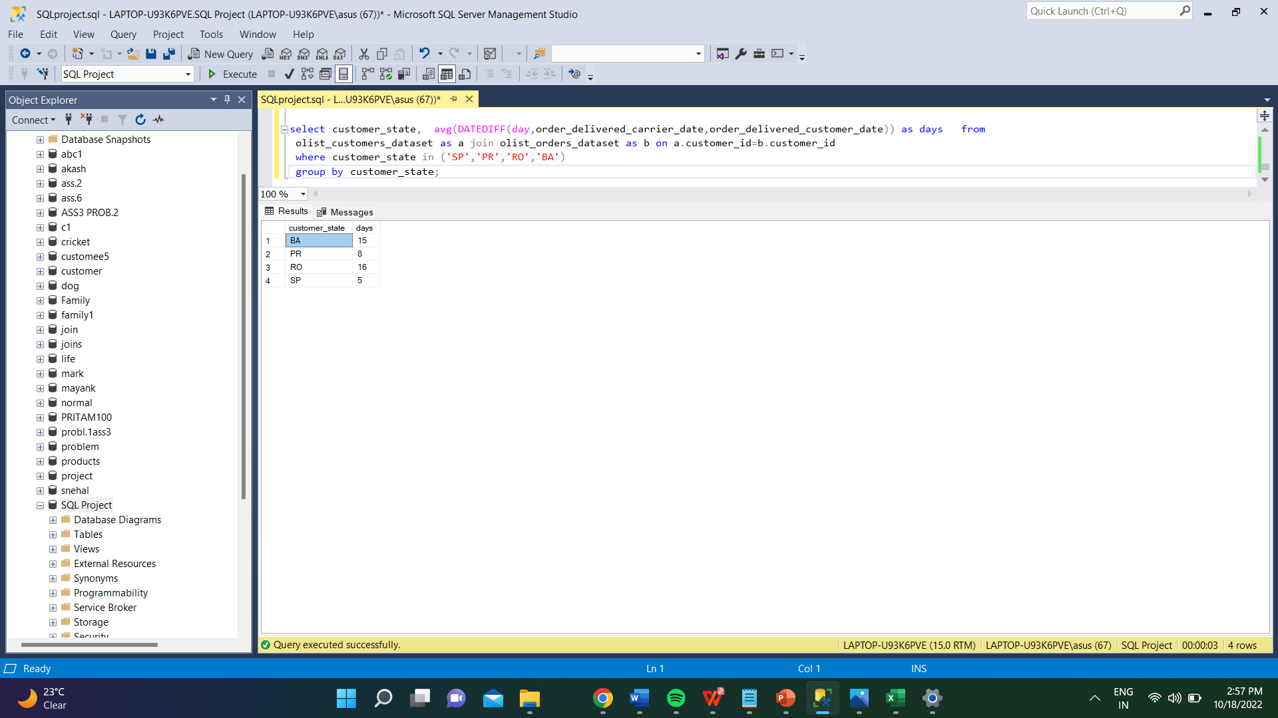
The average Order date for the top state is less than compared to the bottom state

Slide 17
Customer_state | Days
BA | 15
PR | 8
RO | 16
SP | 5
The average Order date for the top state is less than compared to the bottom state

Slide 18
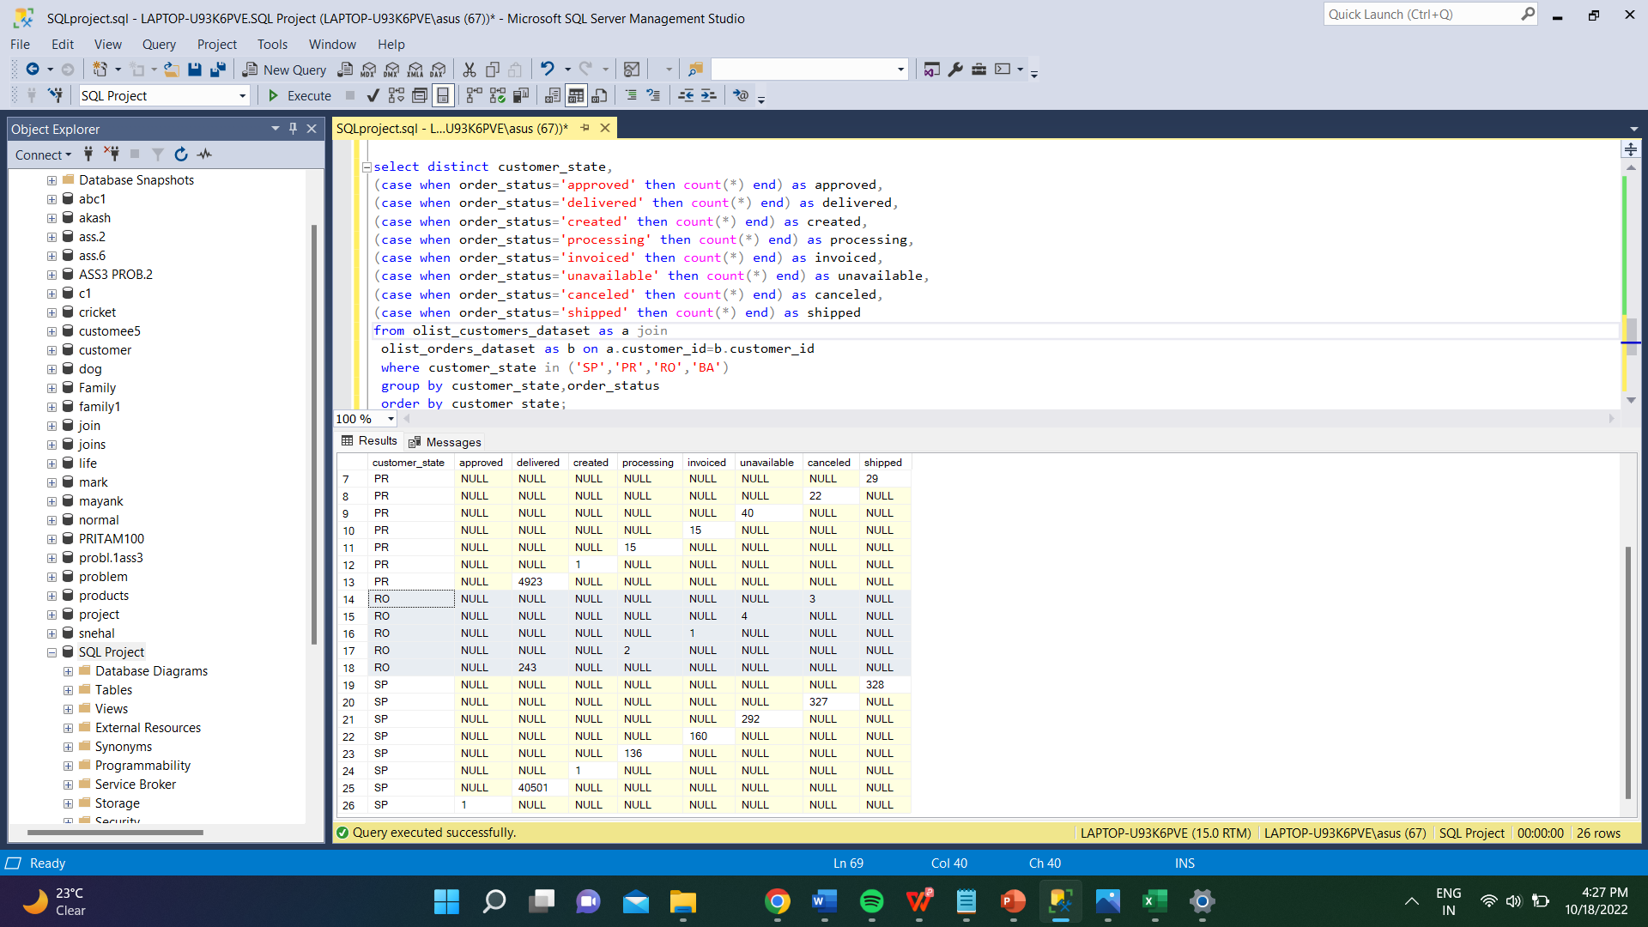
The Order status of Top and Lowest state – Top state has order status high in every status

Slide 19
customer_state | Approved | delivered | created | processing | invoiced | unavailable | canceled | shipped
BA | 0 | 3256 | 0 | 11 | 9 | 20 | 16 | 68
PR | 0 | 4923 | 1 | 15 | 15 | 40 | 22 | 29
RO | 0 | 243 | 0 | 2 | 1 | 4 | 3 | 0
SP | 1 | 40501 | 1 | 136 | 160 | 292 | 327 | 328
Order status for top inclined and declined trend state

